Slide 1

Gibrán Lemus & León García
Wizeline, Guadalajara, México
Software development with a lean mindset & DevOps

Slide 2




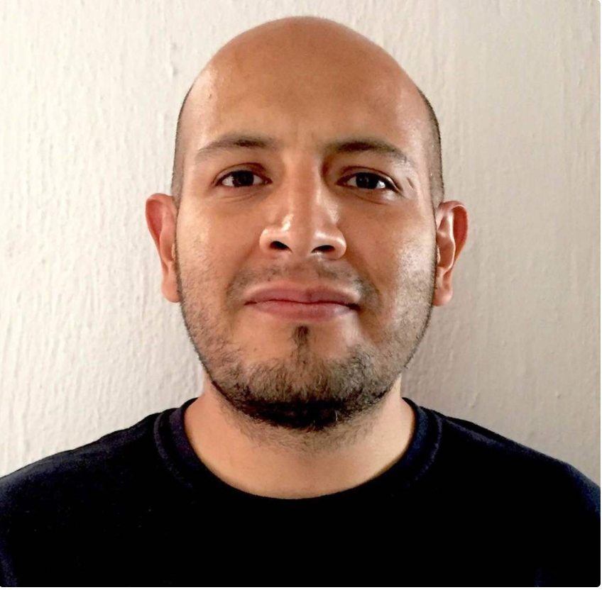
Gibran Lemus
Sales Operation Manager @ Wizeline
Quality enthusiast & waste slayer
@ggberto
León García
Director of Engineering @ Wizeline
I do stuff
@chitopunk

Slide 3

The Problem
Delivery
Uncertainty about why projects are not finished on time.
Teams working crunch time to complete the commitments.
Lack of quality, no CI/CD, meaningful tests, poor automation.
Lots of manual intervention during deployment phases.
Metrics
No way to gather information about the status of the project.
No way to improve due to the lack of information
“If you can’t measure it, you can’t improve it”
Notes:
Leon
Wizeline is a services company with operations in Mexico, US, Europe and Vietnam.
We have different challenges, we need to commit to dates for delivering, sometimes estimating is hard and could put us in difficult situations.
Engineers have to work extra to deliver our commitments
Due to the limited deadlines, some teams do not implement tests, CI, automation.
There's a lot of manual
We want to understand more about this problem and data is something that is commonly missing in many of these projects.

Slide 4
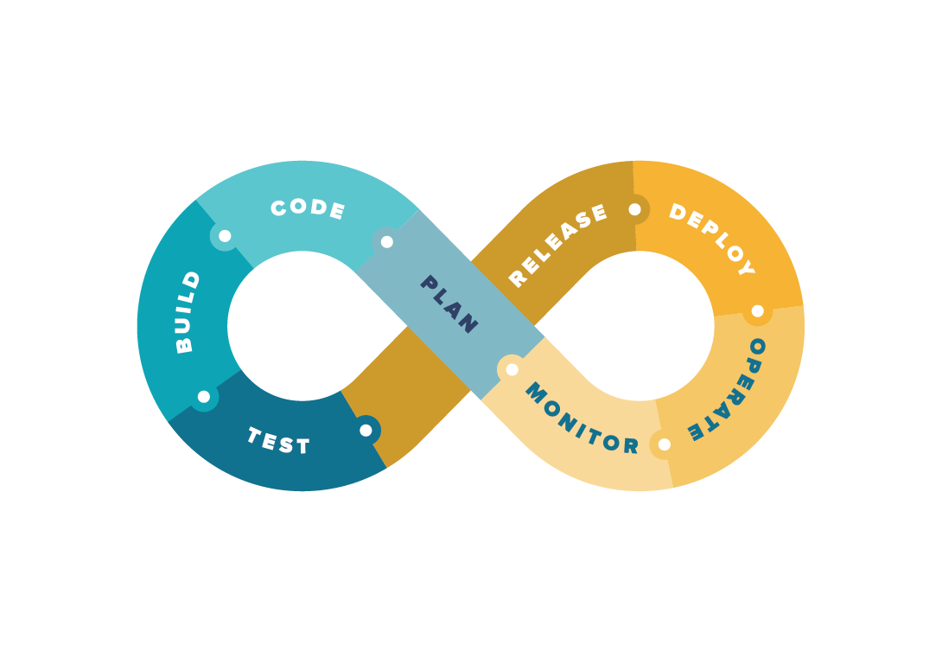

The Goal (DevOps culture + lean)
DevOps KPIs
Lead time
Deployment Frequency
Mean Time to Restore
Change failure Percentage
Notes:
Leon

Slide 5




The Goal (DevOps culture + lean)
DevOps as a Cultural Movement
Embrace DevOps for all engineering teams.
  Make it part of your onboarding process
  Education in areas such as automation, system operations, IaC, CI/CD
Explain how the use of some tools help to achieve business objectives
  Lean as a tool for improvement
  Experimentation culture, Hypothesis validation and measurements
  Automation
Implementing DevOps practices and tools can benefit your organization in:
Faster time to market of the new releases
Quick recovery from the project failures
Continuous Integration and Delivery through robust deployment model
Gather metrics that can be used as input and help in the decision-making process for a new iteration.
Hard
Medium
Easy
Notes:
Leon
DevOps is a culture or philosophy. It is not a process, methodology, or framework. When you decide to implement DevOps in your organization, you need not necessarily get rid of existing processes and tools, rather you adapt to discipline, in your product development life cycle.
To leverage the benefits of DevOps transformation in your organization, you can use several tools, methods, disciplines, etc, to achieve your business objectives and enhance the customer experience. Methods and disciplines such as Lean.

Slide 6

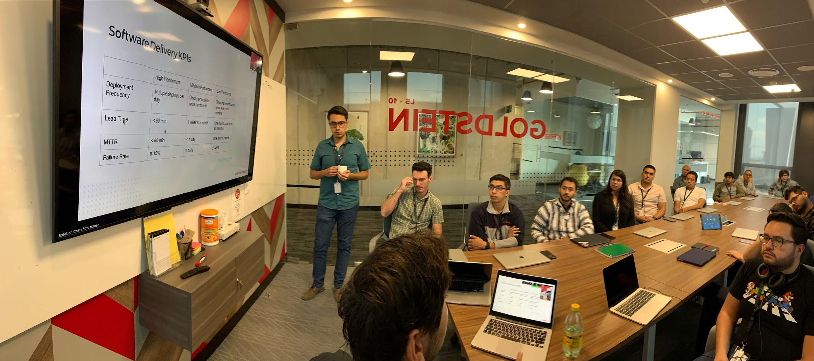
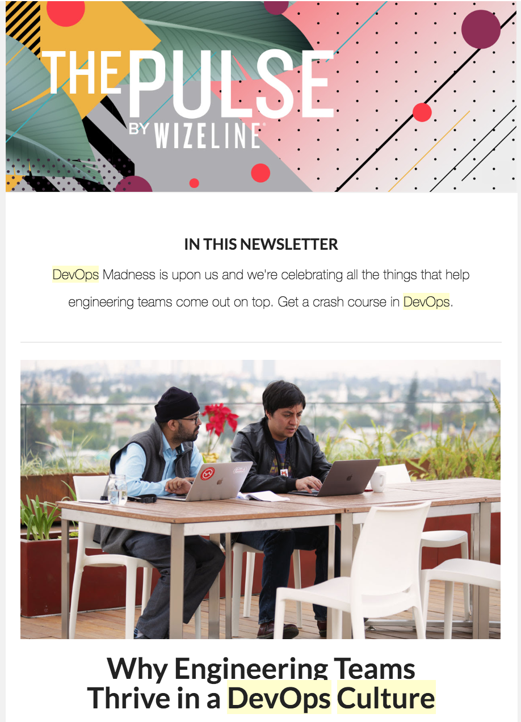
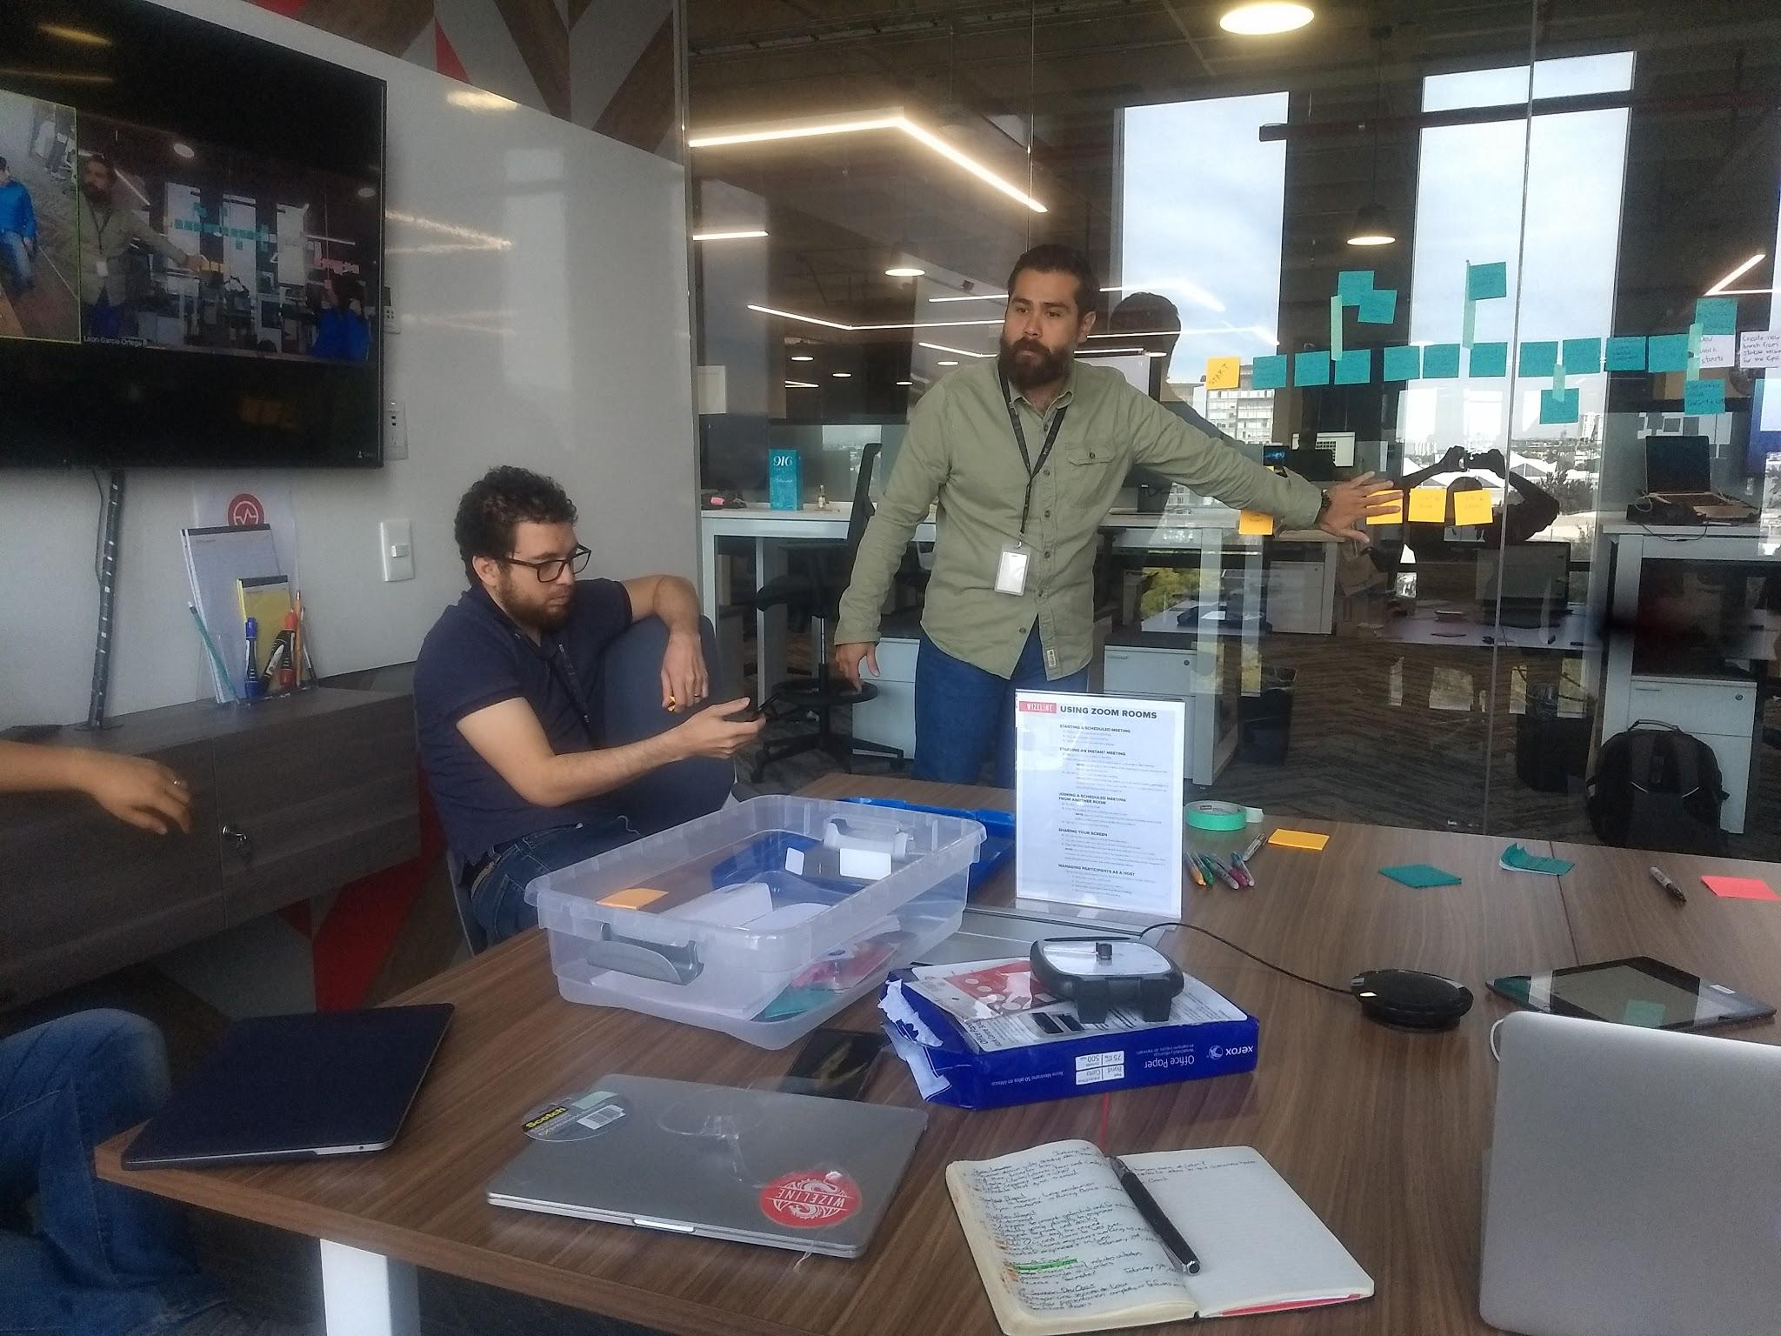
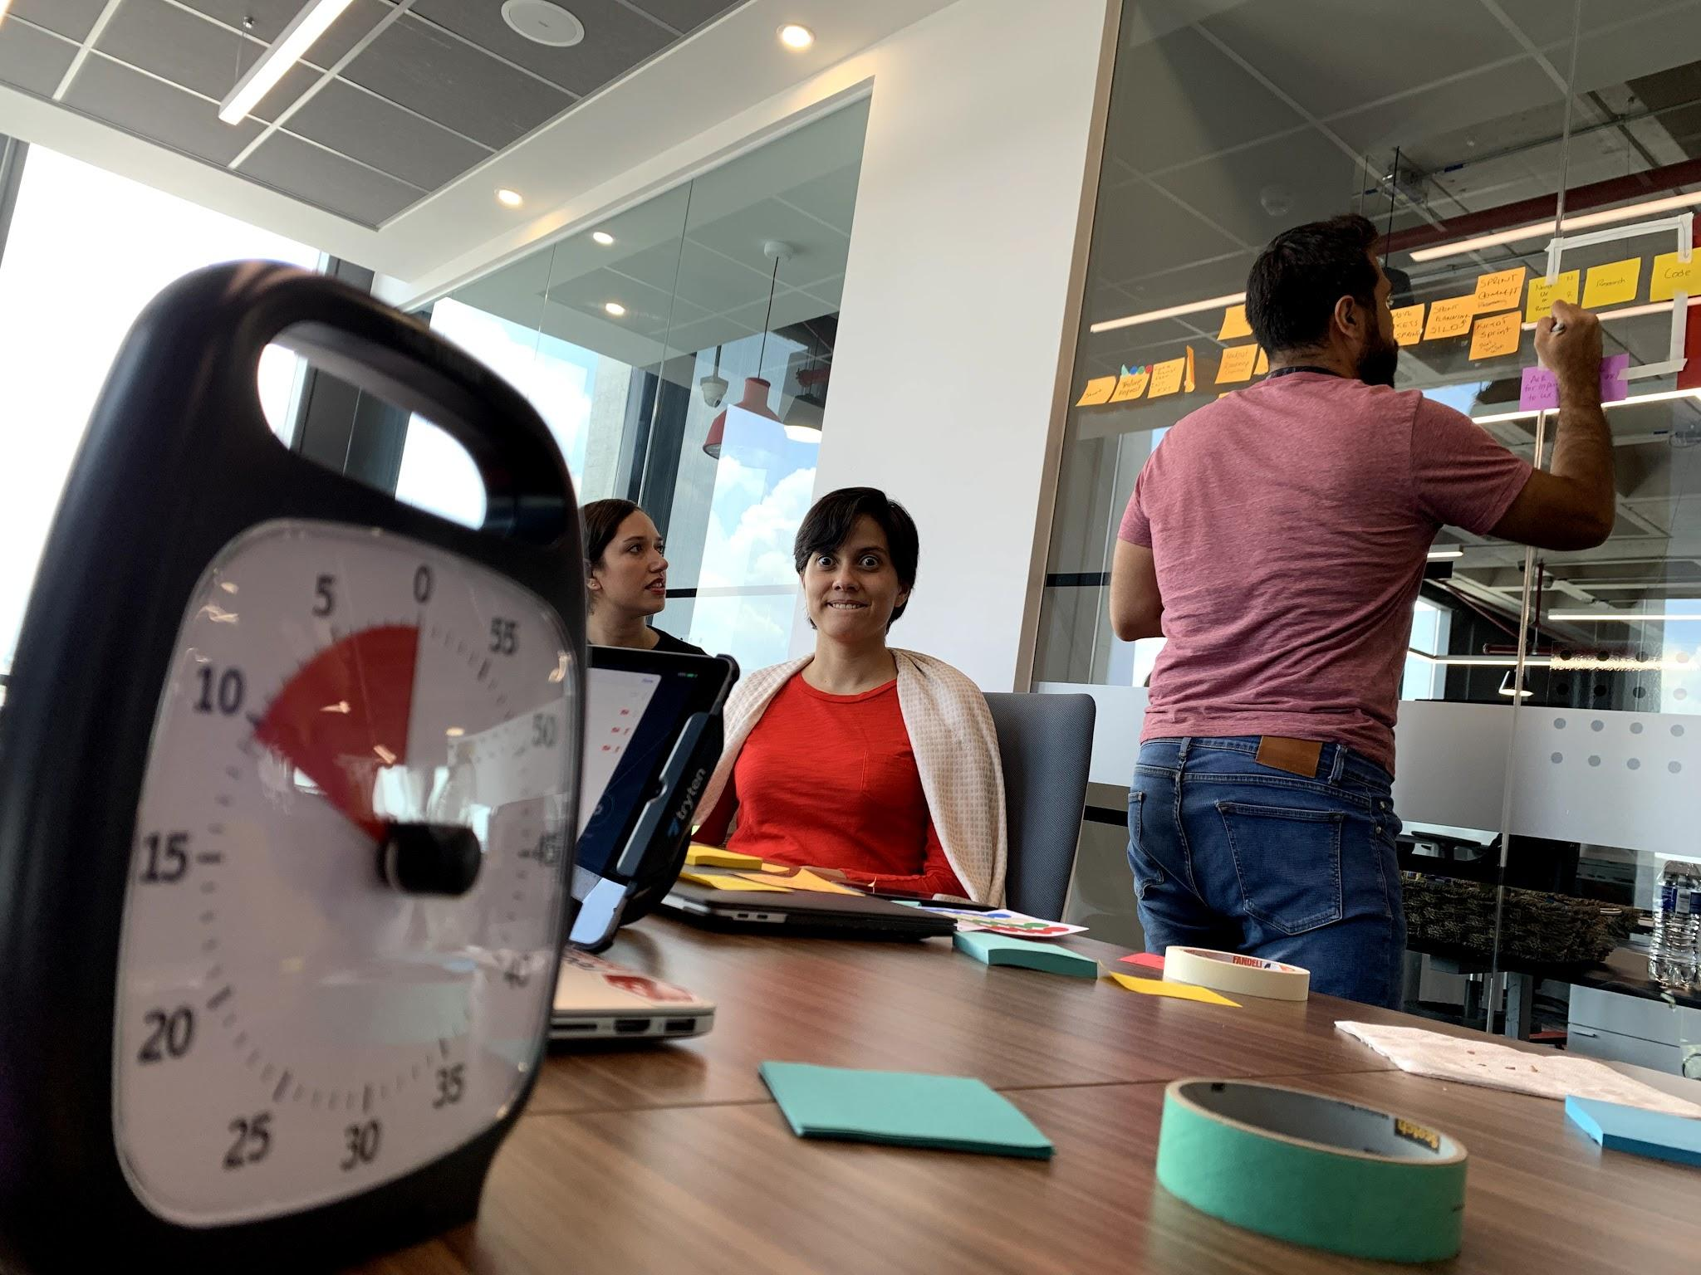
The Goal (DevOps culture + lean)
DevOps as Cultural Movement
Notes:
Leon

Slide 7
Our Approach
DevOps Principles
Plan
Code
Build
Test
Release
Deploy
Operate
Monitor
Define
Measure
Analyze
Improve
Control
Lean Six Sigma Framework DMAIC
DevOps principles will be aligned with the Lean Six Sigma data-driven quality strategy for improving processes, DMAIC, in order to build a replicable set of steps for their application.
Notes:
Gibran
We were unsure about how to implement DevOps and we wanted to avoid just setting metrics without understanding where they come from and what to do with the lectures of these metrics, so we experimented a bit. Given that not all the teams are experts in automation, testing or managing infrastructure we decided to go with a more lean-oriented approach. Through Lean and its tools, we would be able to set a baseline for improvement, to understand where we are standing and what feeds our metrics. And to focus on what brings value and continuous improvement to our processes, answering the question, what to do with the lecture of our metrics.

Slide 8
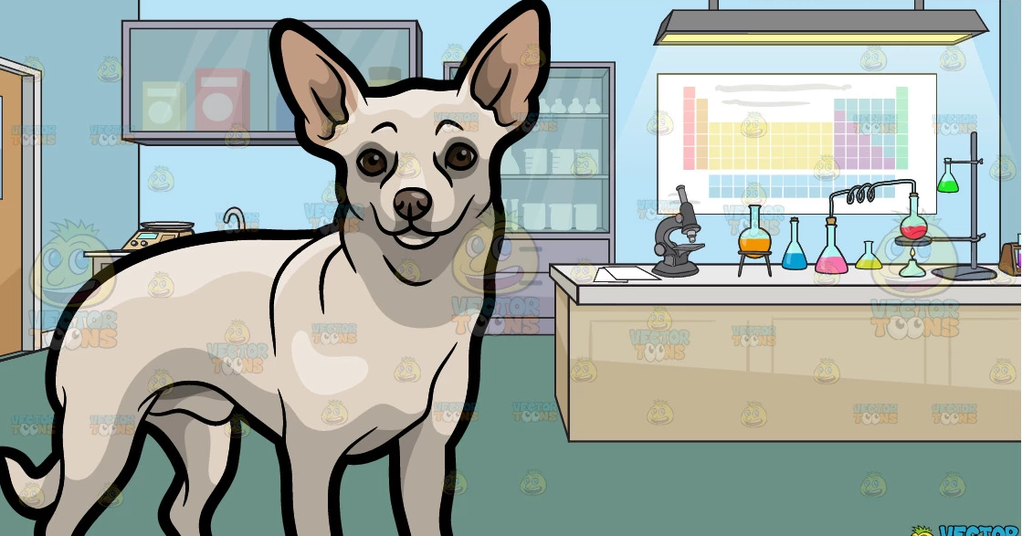
Our Approach
Experimentation
Select a team to Transform
  Pick a team willing to commit and thrive.
  Make sure everybody understands DevOps and Lean
Explain the 4 DevOps KPIs (from Accelerate book)
Understand where we are at
  Creating a “As Is” Process Map of the current development process
Understand what provides value and what not
  Create a Value Stream Map
Set a baseline for metrics and measure
Make improvements
Measure again and celebrate
Notes:
Steps for experimentation:
Select projects to run this experiment. Projects with teams willing to implement DevOps practices.
Explain to the whole team how using the principles of Lean, the goal is to implement the 4 DevOps KPIs.
Begin DevOps Implementation with the help of Lean tools:
Create a workflow to identify owners, decisions constrains but above all a consensus of what we do and how we do it
Create a Value Stream Map based on the Software Development life cycle, with two objectives:
From all the activities identified in the Workflow, categorized them into value add and non-value add.
Understand which activities actually integrates our 4 DevOps metrics and then implement the metrics.
Start the measurement of all activities in the VSM, this will give us our first metrics lectures
Make improvements based on our Workflow and VSM and support our action also with lean tools like the 5 Whys.
Measure again, and compare the as is lecture against the lecture after improvements to validate the value of the DevOps implementation.

Slide 9
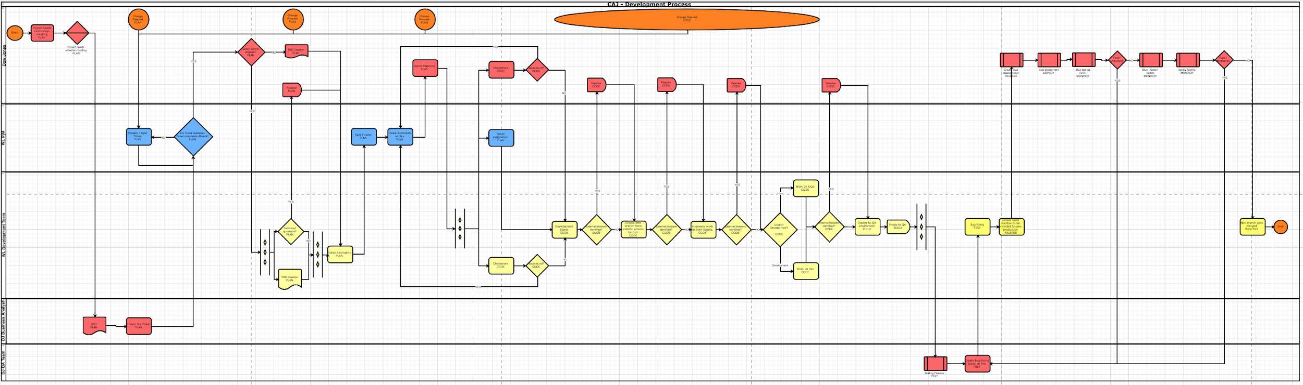
Our Methodology
Create a “As Is” Process Map
Create the map of the current Software Development Cycle
  Think as "From brain to production"
Organizing a review meeting with an engineering team
Brainstorming over the various aspects of software development life cycle
Drawing the project workflow of different steps performed by the team
Identifying the engineering streams with different color codes
High-Level Steps for a Successful Process Map Creation

Slide 10

Our Methodology
Create a “As Is” Process Map
Outcomes
Define how things actually work
Identify all current activities - inputs for our VSM
Identify owners - decision makers
Identify low-hanging fruits - quick improvements
Have a visual representation of how we work (this is super valuable)
Findings
After running these workshop with different teams, all process maps looks completely different.
The interesting thing is that all teams are creating software.

Slide 11

Our Methodology
Create a VSM (getting creative)
After a lot of reading and understanding how we could achieve this part. We are pretty sure that each step of our SDLC is really the value chain in our VSM. In essence these are the steps to create a VSM out of the process map.
Select all tasks related to each stage of the DevOps Value Stream (SDLC)
List all tasks in order inside a bucket of the value chain.
Identify the artifacts that should be used as input for the next steps
It's more likely that there will be no steps in the process related to certain areas such as monitoring, operation or deployment. (It's important to start digging further about this)

Slide 12
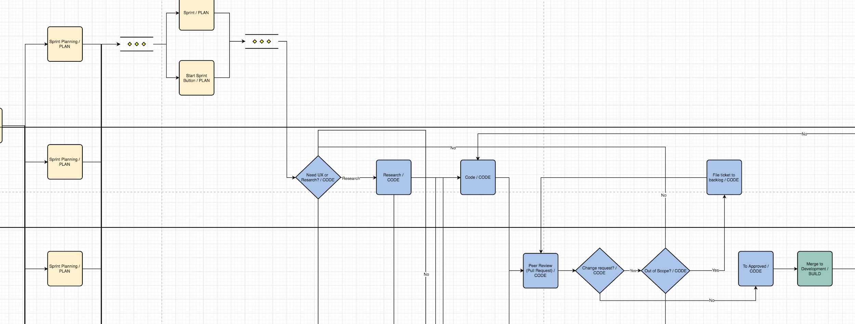
Our Methodology
Link all activities to the DevOps VSM

Slide 13

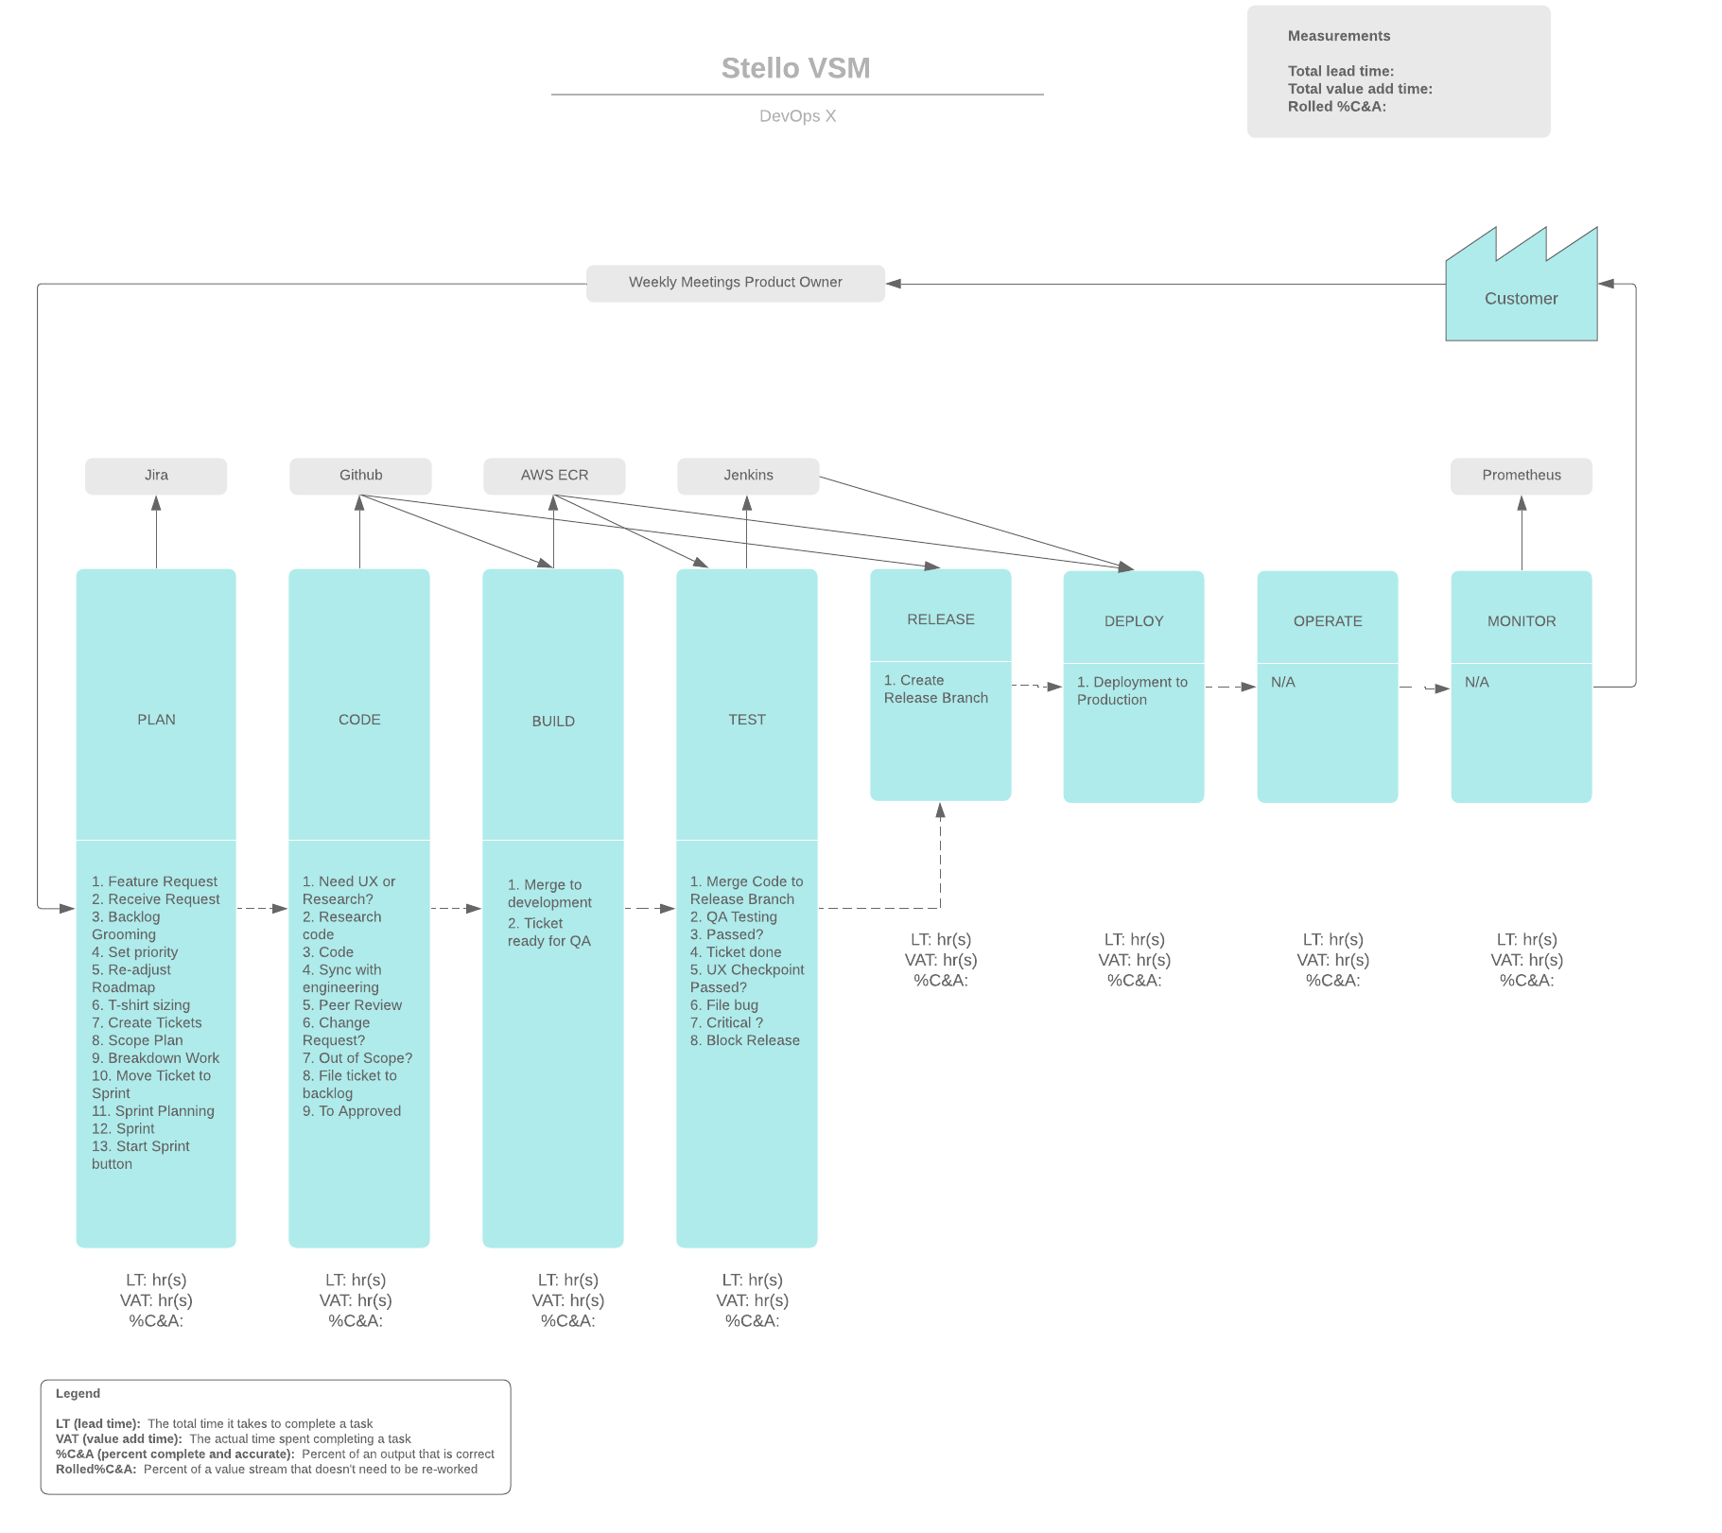
Our Methodology
Create a VSM (getting creative)

Slide 14

Our Methodology
Create a VSM (getting creative)
Outcomes
Identify our value add activities - Improve them and reduce waste.
Categorize these activities within the SDLC - Develop a software development standard for our future projects.
Identify those activities that will become inputs for our 4 KPIs - Understand where our KPI come from.
Generate a baseline for our metrics

Slide 15
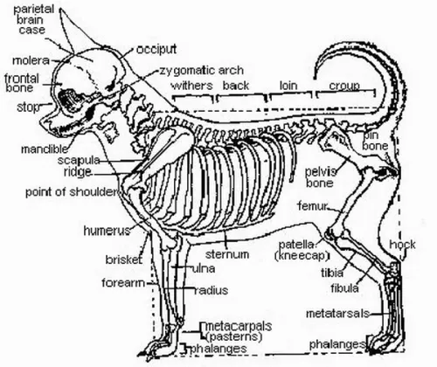
To Do….
Next steps (in progress)
Start implementing measurements with all the teams
Every team can analyze their data
Propose and execute improvements
Measure again
Identify improvements (if any) - repeat cycle
Notes:
Leon

Slide 16
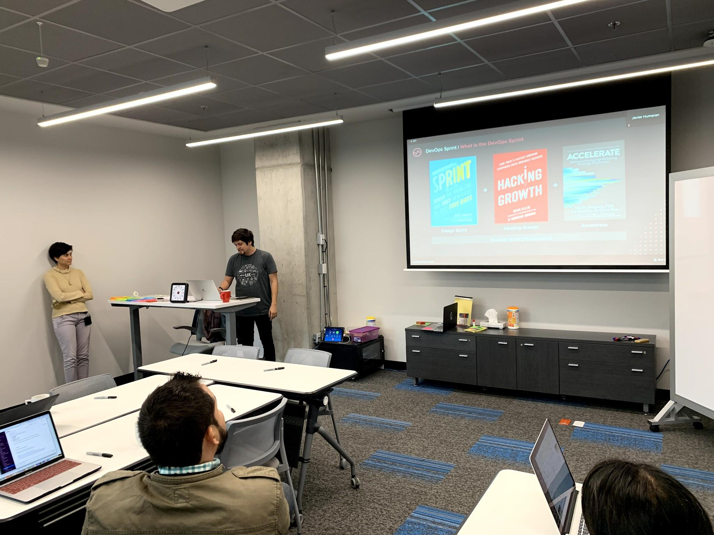
Improvement Time
More experimentation
Evaluate other approaches to reduce time and start with measurements right away.
  Using UX approach
Currently working in a new process "DevOps Sprint"
Notes:
Leon

Slide 17
Thanks!

Slide 18
Backup Slides

Slide 19
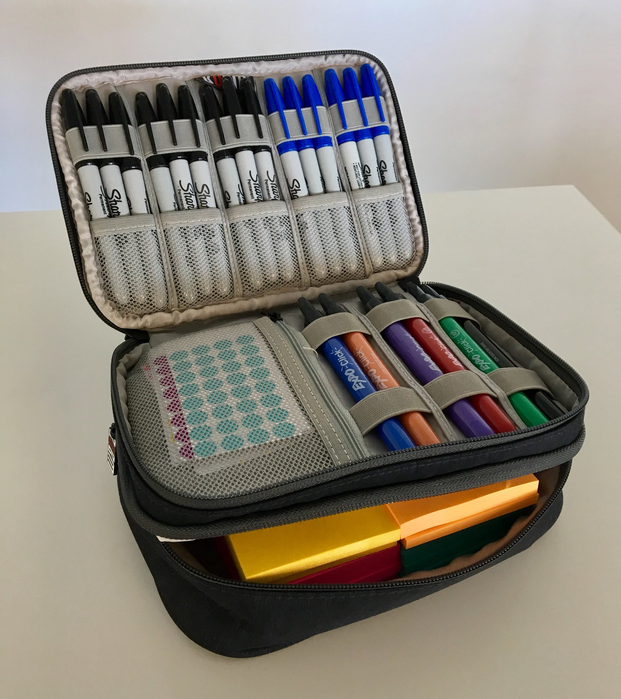
Our Methodology
Create a “As Is” Process Map
Material Needed for the activity
Color Post-its for defining the steps. (have at least 5 or 6 different colors)
Markers for all participants. (so they can write on the post-its)
Dot stickers, to identify owners. (have at least 5 or 6 different colors)
A time timer (or just a timer or google timer)
Colored tape. (painters tape)
A whiteboard or 2, or a large window to stick the post-its
Who participates in the activity (preferred)
A moderator. (2 are ok)
Development team
Project Managers
Quality and Operations
UX / Design team

Slide 20
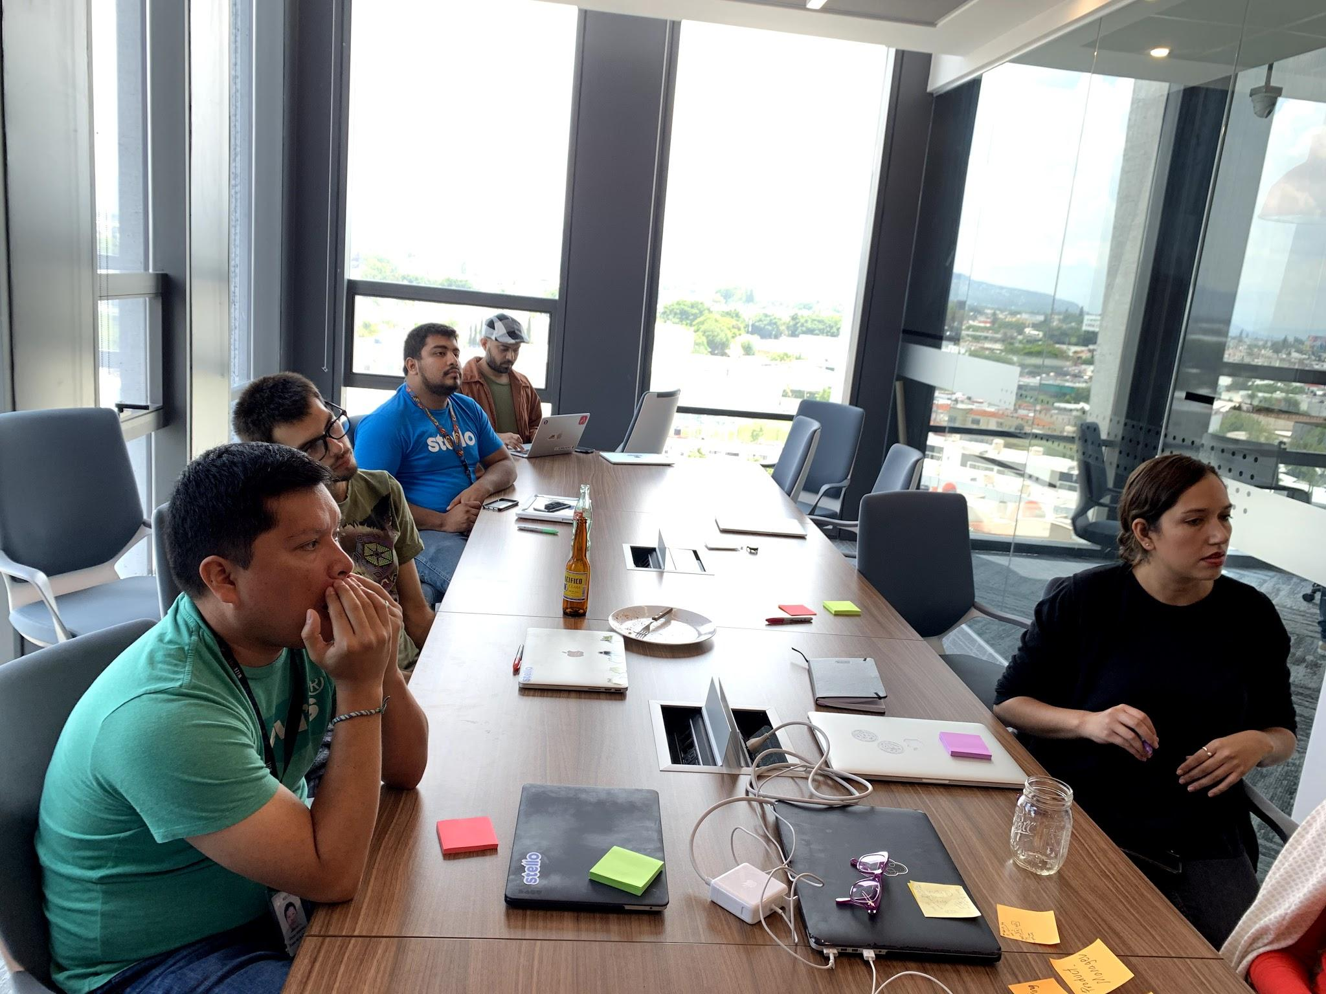
Our Methodology
Create a “As Is” Process Map
Pre-Steps Recommendation (15 min)
Break the ice: Explain what's gonna happen in the workshop
Discuss, Discuss, Discuss: Create the process "as is", not how we want it to be
Challenge each scenario: If some things are not currently happening, step in, and get into an agreement
Note: Based in our experience 2 sessions of 90 minutes can provide enough information to create the current process map.
Notes:
Break the ice: Ensure that each team member understands the importance of this activity. Give a premortem overview to the team before you begin. A very important point to highlight here is that the process map should be "as is".
Duration: 15 min.
Discuss, Discuss, Discuss: Noone is an island. Pour your observations, experiences, decisions, and outcomes.
Duration: During all the activities.
Challenge each scenario: Do not sit idle. Challenge the actions, decisions, and results. Ask hard questions to the team such as “why did this happen?”, “what was the root cause of it?”, “Was there an opportunity to prevent the issue?” and “Did we take any decisions in-silos or collectively by the team?”. This is a time to uncover all risks and opportunities in the project for decoding the project failures and successes.
Duration: During all the activities.

Slide 21
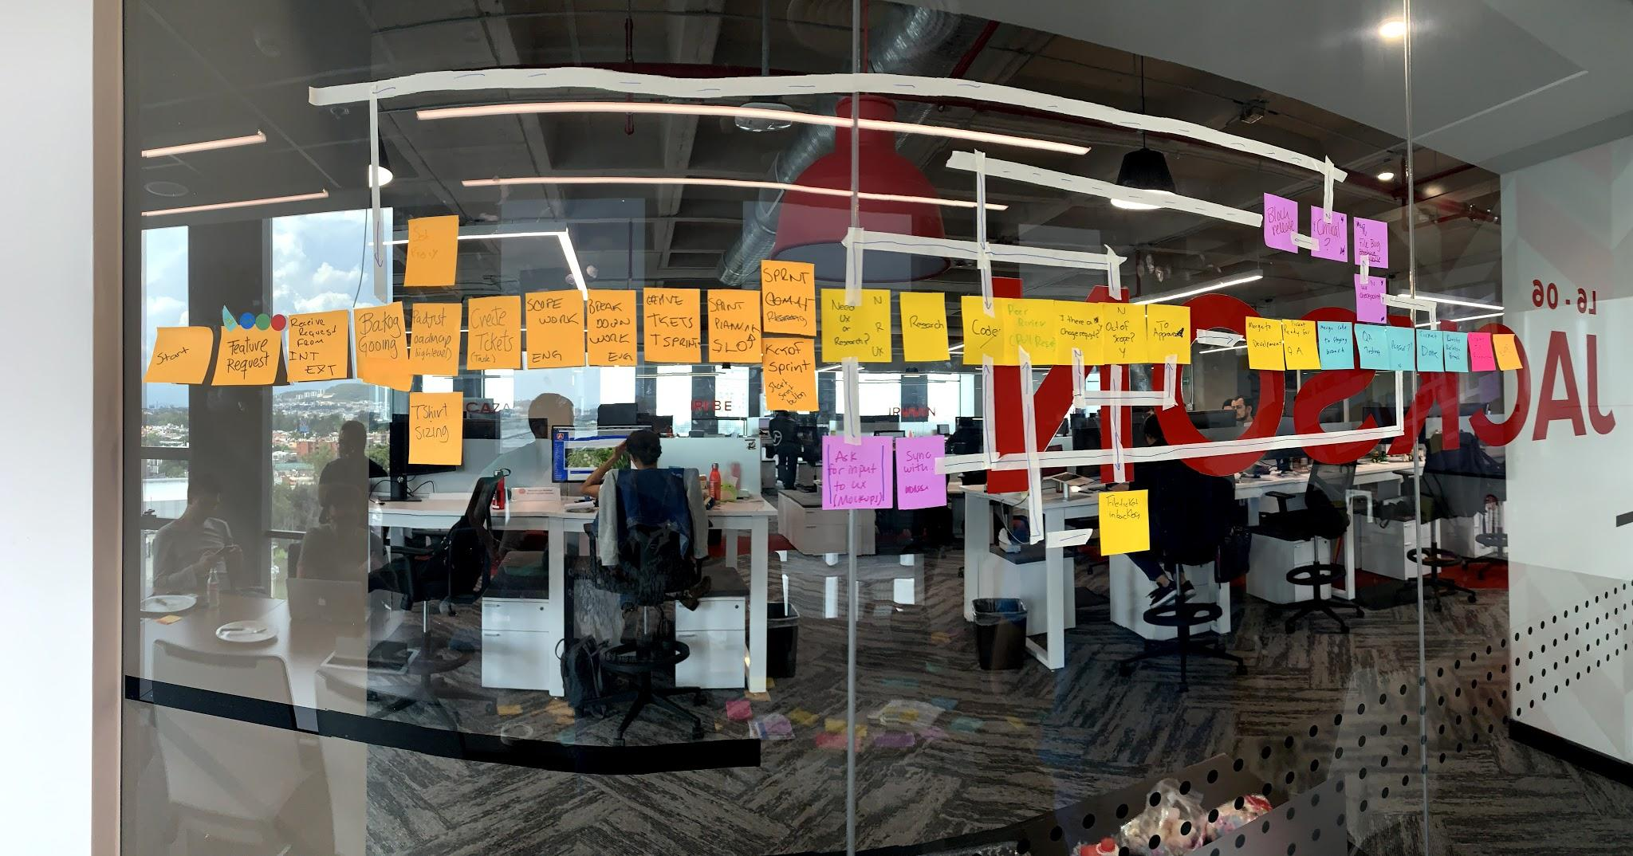
Our Methodology
Create a “As Is” Process Map
Start:
Start labeling: Use color codes for each type of work
Maintain the flow: Arrange post-it in sequence, add atomic steps, try to identify who perform the tasks and assign a color
Make a workflow: Connect post-its with arrows, using markers or tape.
Assign Owners: Paste the color dots to indicate the owners and their duties
Revise the process map: Take a poll and vote for each step for confirming its position and connection in the flow
Raise voice: If you find any redundancies or inaccuracies in the process flow, don’t hesitate to bring up to the table as it may have an impact on the process mapping
Take a snapshot: Take pictures of the flow and share them within the team
Notes:
Start:
Start labeling: Create post-it notes and stick them on the Whiteboard. Each post-it must have only a step in the process, try to add steps that don't have sub-steps. Select the color of your choice for each department as follows:
Development = Green
Testing = Yellow
UX = Blue
Project Management = Magenta
Duration: 60 min.
Maintain the flow: Arrange the post-it in the order in which you all carried out the project. If you performed simultaneous activities, stick them in that sequence. For example, UX and Dev tasks in parallel.
Duration: 60 min (parallel).
Make a workflow: According to the working mechanism, connect the post-its with arrows using markers for creating a workflow of the project.
Duration: 60 min (parallel).
Assign Owners: Paste the color dots to indicate the owners and their duties as follows:
Development = Green
Testing = Yellow
UX = Blue
Project Management = Magenta
Technical Writing = Orange
Duration: 10 min.
Revise the process map: Take a poll and vote for each step for confirming its position and connection in the flow.
Duration: 10 min.
Raise voice: If you find any redundancies or inaccuracies in the process flow, don’t hesitate to bring up to the table as it may have an impact on the process mapping.
Duration: 10 min (parallel).
Take a snapshot: Take pictures of the flow and share them within the team.
Duration:10 min.

Slide 22
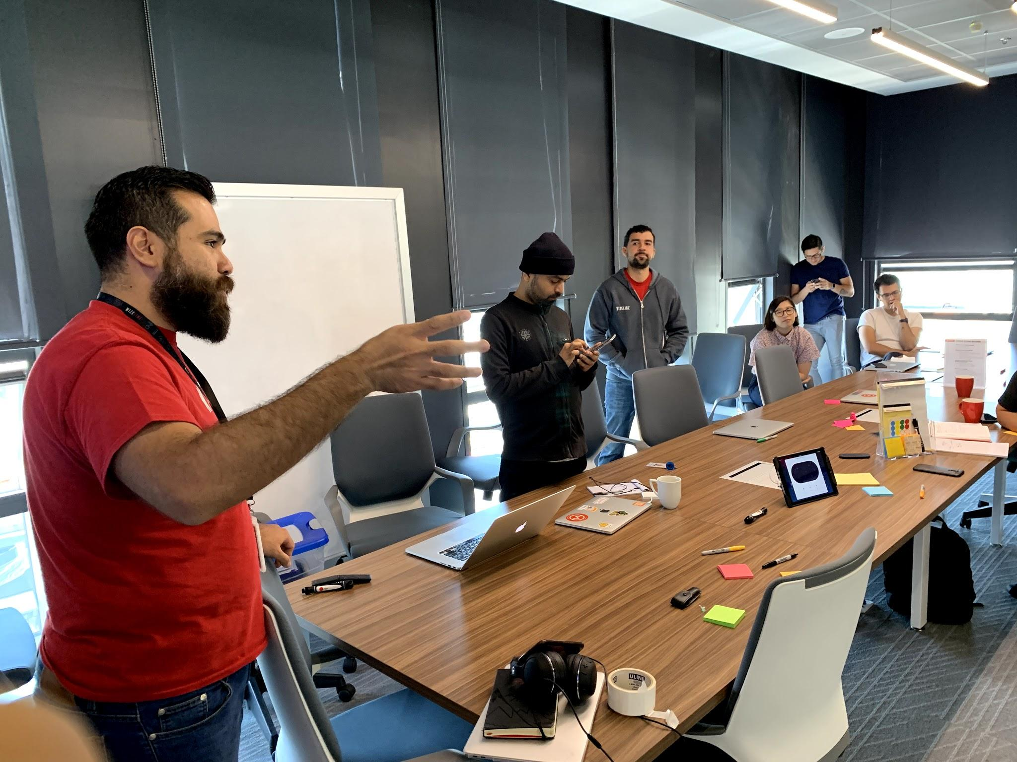
Our Methodology
Create a “As Is” Process Map
Post Steps
Create a digital version of the map: draw.io for such
Identify each step as part of the DevOps VSM: Each step in the process must belong to a single stage of the SDLC (devops infinite)
Reunite the team: Re-review the process, step by step and confirm with the team to have a process map "as is"
Tweak the process map: if it's needed make the appropriate changes to the process map and re-send for confirmation
Notes:
Break the ice: Ensure that each team member understands the importance of this activity. Give a premortem overview to the team before you begin. A very important point to highlight here is that the process map should be "as is".
Duration: 15 min.
Discuss, Discuss, Discuss: Noone is an island. Pour your observations, experiences, decisions, and outcomes.
Duration: During all the activities.
Challenge each scenario: Do not sit idle. Challenge the actions, decisions, and results. Ask hard questions to the team such as “why did this happen?”, “what was the root cause of it?”, “Was there an opportunity to prevent the issue?” and “Did we take any decisions in-silos or collectively by the team?”. This is a time to uncover all risks and opportunities in the project for decoding the project failures and successes.
Duration: During all the activities.

Slide 23
Our Methodology
In order to create a process map and a Value Stream Map
Schedule 1 or 2 meetings with your team to map your process
  90 minutes
  Include all team members, (PjM, QA, Dev, Ops, Product Owners)
  If you are running these sessions with remote attendees, use a camera or try to use mural.co
Create a digital version of the map (use draw.io, lucidchart or any other tool)
Reunite with the team to validate the process map
  Ask them to change or adjust if it's necessary
Work with the final version of the process map and identify actions to the DevOps VSM (plan, code, build, test, etc)
Create a new VSM using the different stages of the DevOps VSM
Use the Process Map to add all the tasks identified on each stage to your VSM
Identify the systems used in transitions of the value chain as outputs and inputs
Measure each step and identify if the task adds value or is just an enabler

